Slide 1
Computer Vision
Digital Image Formats: An Introduction
Dr. Umberto Michelucci, Dr. Aygul Zagidullina
Dr. Dimitris Mousadakos

Slide 2
Learning Objectives
Navigate and utilize PyTorch
Understand the foundational principles of Convolutional Neural Networks
Comprehend the concept and value of Transfer Learning
Work on your first CNN and Transfer Learning models using PyTorch

Slide 3
Raster and Vector images
Raster Images
Image made of pixels
Resolution dependent (cannot be scaled up or down without loss of quality)
Raster Formats: jpeg, jpg, pgf, png,, raw, rgba, tif, tiff
Vector Images
Made of lines and curves drawn with mathematical equations (Bezier curves for example, see https://pomax.github.io/bezierinfo/)
Not resolution related
Can be resized without loss of quality
Vector Formats: svg, svgz, eps, pdf, ps
In Deep Learning we work with Raster images only.

Slide 4
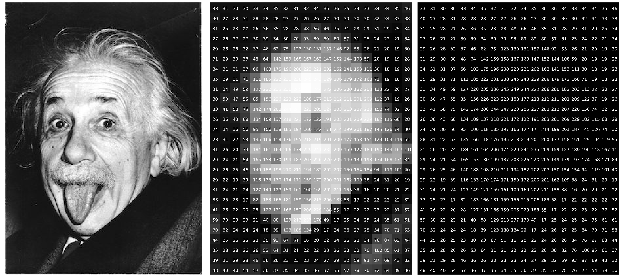
Raster image – an example

Slide 5
Vector images in Deep Learning Research
Vector images are not used to train deep learning models but…
They should be used in publications as they can be scaled and appear very sharp when published on papers or posters (typically in A0 format).
Matplotlib can easily export in vector formats (EPS, PDF, etc.) any figure you generate

Slide 6
Image features
Resolution (relevant for quality)
Dot per inch (DPI) (relevant for printing)
Compression (relevant for storage and quality)
Transparency
Anti-aliasing
And many more.
In deep learning normally those features (except resolution) are irrelevant.

Slide 7
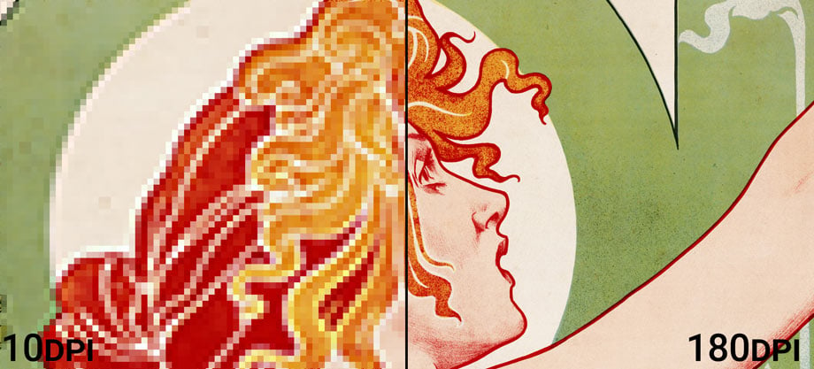
DPI: an explanation
https://prinfab.com/blog/viewing-distance-and-dpi/

Slide 8


DPI: an explanation
~ 220 dpi
~ 400 dpi
https://prinfab.com/blog/viewing-distance-and-dpi/

Slide 9
Characteristics of images
Image size (storage space).
Image resolution.
Number of channels (1 for B&W, 3 for colors in RGB and 4 for CMYK, 4 with transparency).
Color Depth (number of bits to describe the color).
Compression (lossless or lossy).
Specific formats (way in which the information is stored digitally).

Slide 10
Color Depth
Color depth also known as bit depth, is either the number of bits used to indicate the color of a single pixel (8 bit, 10 bit).
When referring to a pixel, the concept can be defined as bits per pixel (bpp).
When referring to a color component, the concept can be defined as bits per component, bits per channel, bits per color (all three abbreviated bpc).

Slide 11
Colors and Resolution in Deep Learning: some notes
Colors may contain information and thus increase deep learning model performance.
This is not always obvious and needs to be tested.
The optimal resolution needs also to be tested. Large resolution will lead to very slow training.
Almost all pre-trained models expected specific resolution, so resizing is often needed.

Slide 12
Python libraries for image processing
Pillow/PIL - https://pillow.readthedocs.io/en/stable/
openCV - https://opencv.org/
Scikit-Image - https://scikit-image.org/
Scipy (it does offer some machine learning algorithms, as face detection) - https://scipy.org/
Mahotas - https://mahotas.readthedocs.io/en/latest/
TensorFlow - https://www.tensorflow.org/api_docs/python/tf/image
PyTorch - https://docs.pytorch.org/docs/stable/index.html

Slide 13
Image Formats for PyTorch
PyTorch uses PIL (Python Imaging Library) or torchvision for image loading
Supported Formats:
JPEG, PNG, BMP, GIF, TIFF, WebP
Best Practice: Use JPEG or PNG for most tasks due to wide support and efficiency

Slide 14
Image Formats for TensorFlow
TensorFlow uses tf.io and tf.image modules
Supported Formats:
JPEG, PNG, BMP, GIF
TFRecord: TensorFlow’s own binary format for large datasets
The datatypes are all Tensors, thus the code is optimized and no conversions are needed.

Slide 15
Code Discussion
Introduction to Image Processing

Slide 16
Computer Vision
CNN Basics
Dr. Umberto Michelucci, Dr. Aygul Zagidullina
Dr. Dimitris Mousadakos

Slide 17
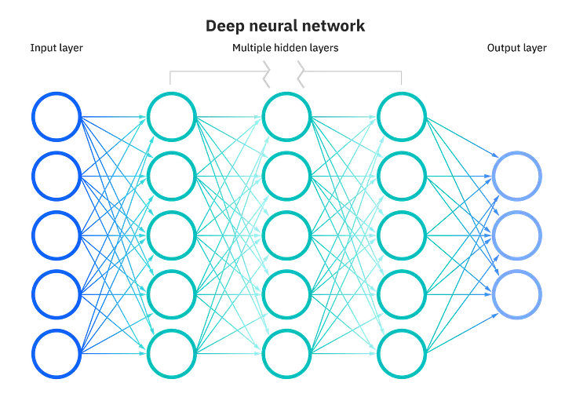
Can we make computer vision with NNs?
(n x m) input nodes
Source

Slide 18
Can we make computer vision with NNs?
Disadvantages:
For high resolution, huge amount of weights. Solution does not scale.
An image with a slight shift by one pixel, makes it no clear that will classify correctly
Usually, each pixel has a correlation with its neighbor pixels. We can not catch patterns

Slide 19
We need a robust solution: CNNs
Feature extraction
+

Slide 20
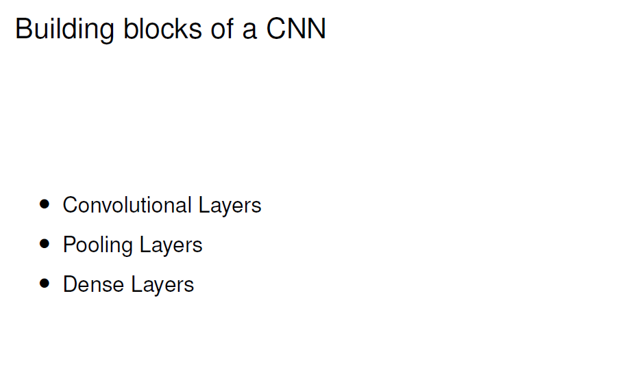
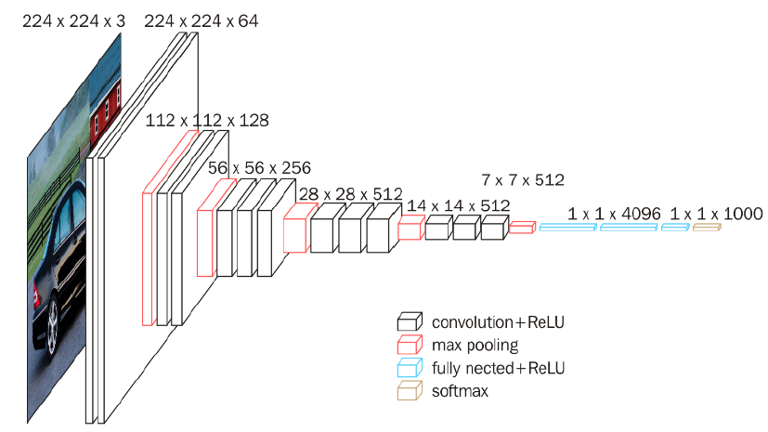

Slide 21
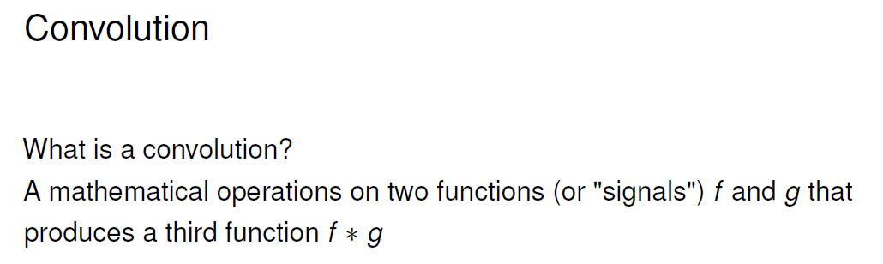
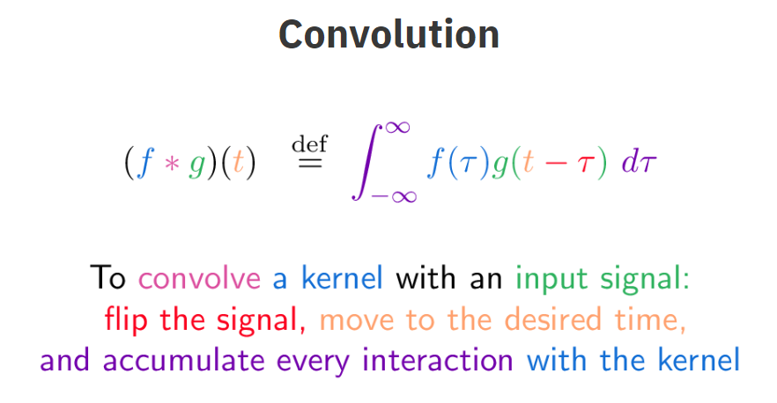

Slide 22
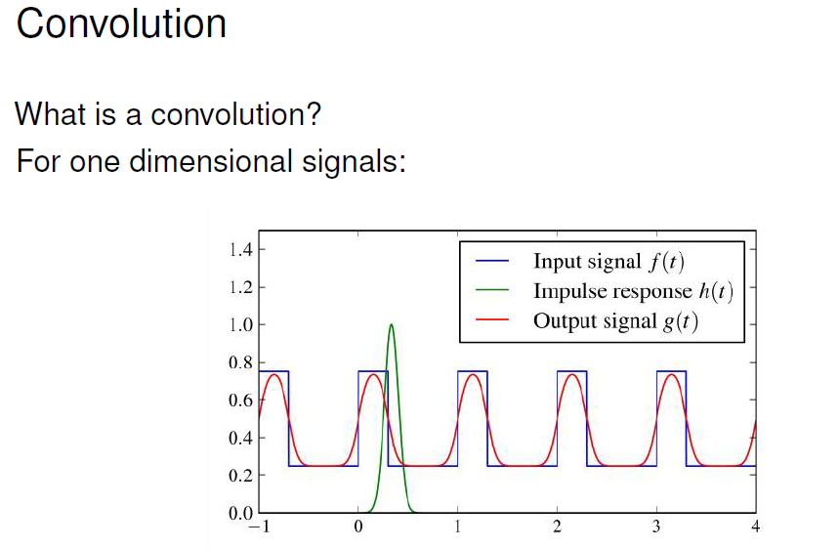

Slide 23
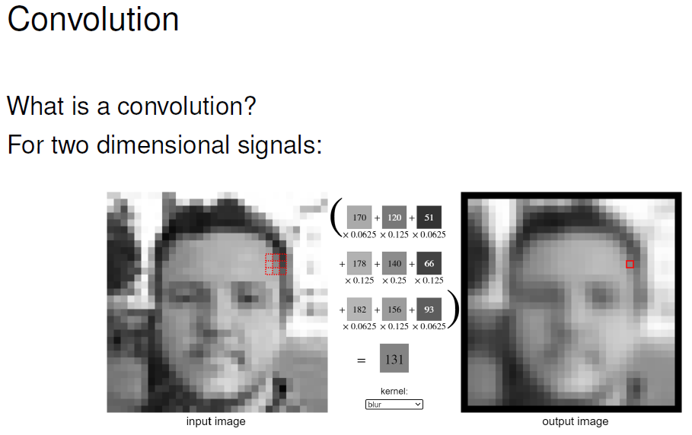
https://setosa.io/ev/image-kernels/

Slide 24
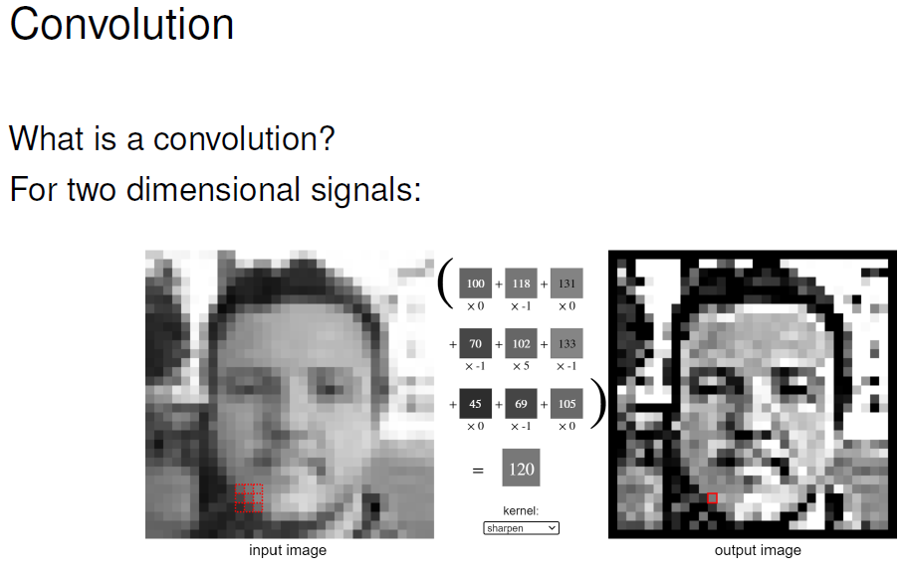

Slide 25
Advantages using Convolution
Reduce the number of input nodes (less computations).
Tolerate shifts on the images.
Take advantage of the pixel correlation in complex images.

Slide 26
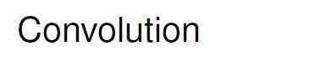


Slide 27
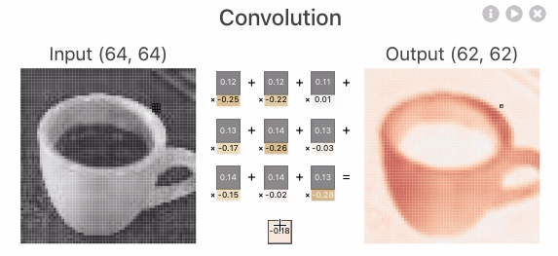
Source

Slide 28
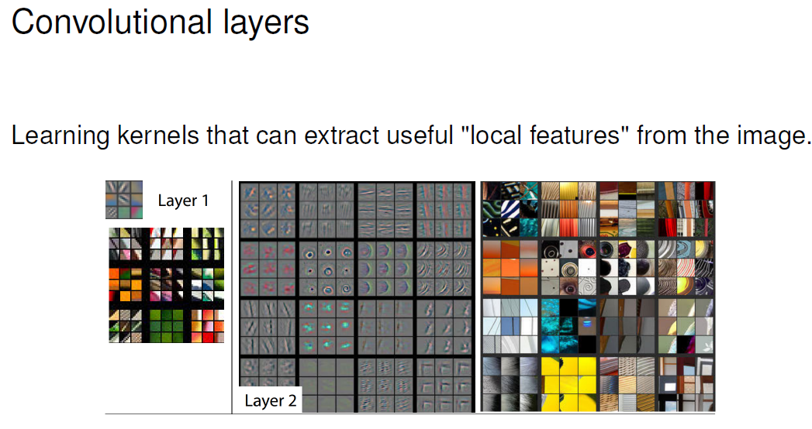

Slide 29
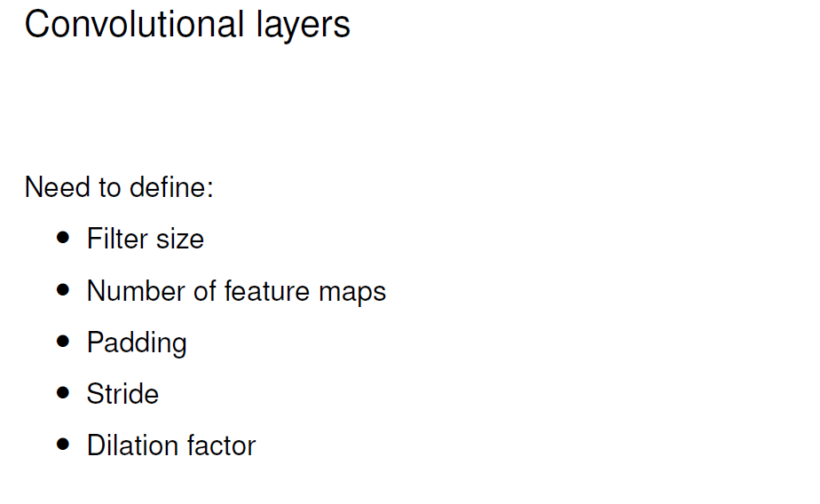
https://github.com/vdumoulin/conv_arithmetic
https://d2l.ai/chapter_convolutional-neural-networks/conv-layer.html
https://stanford.edu/~shervine/teaching/cs-230/cheatsheet-convolutional-neural-networks#layer

Slide 30
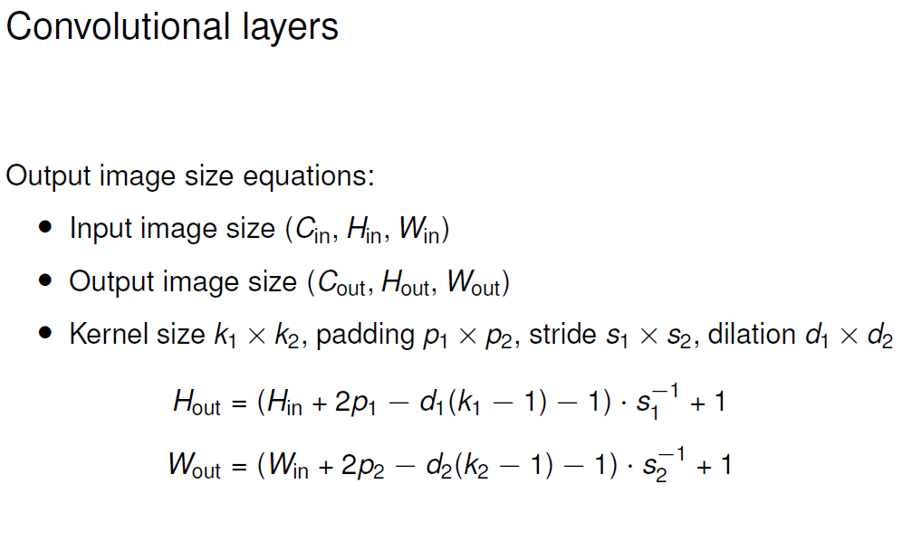

Slide 31
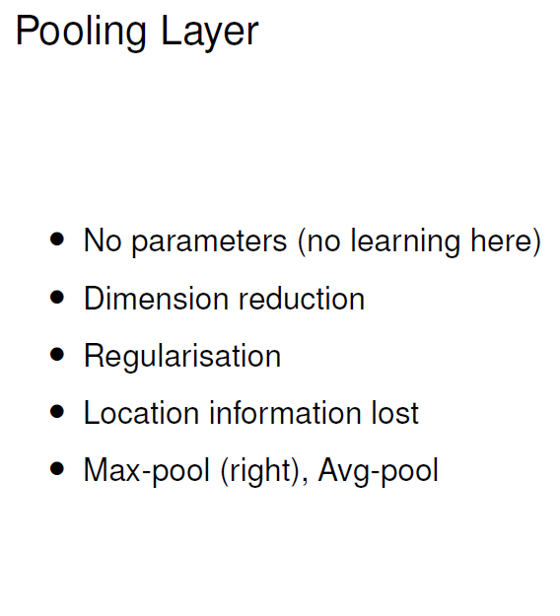


Source

Slide 32
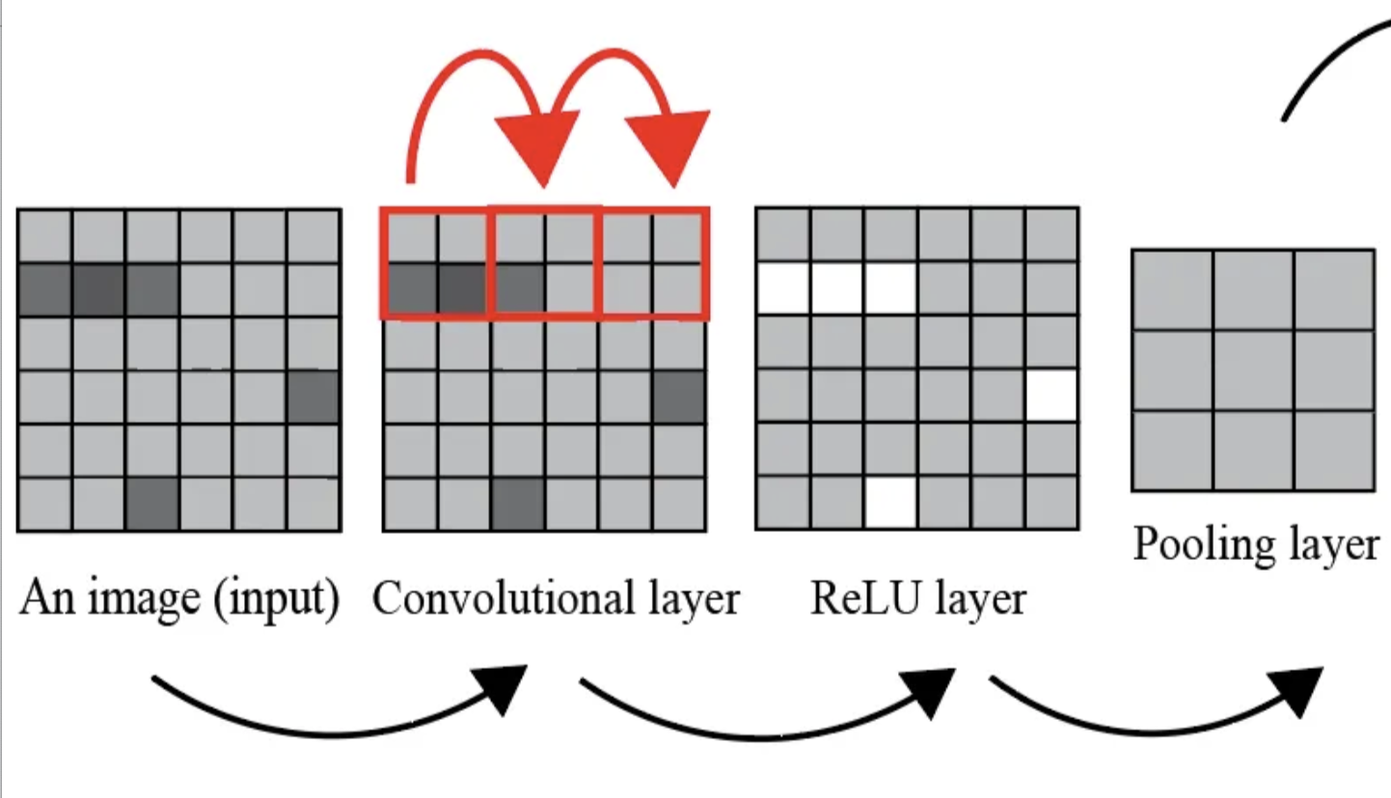
Put all together
Source

Slide 33
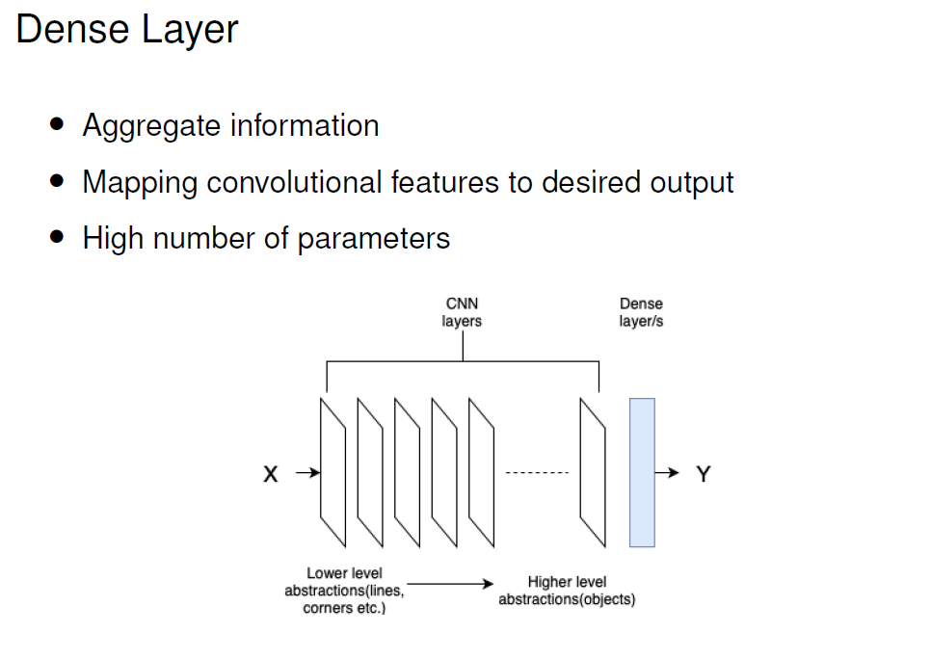

Slide 34

Feature extraction
Source

Slide 35
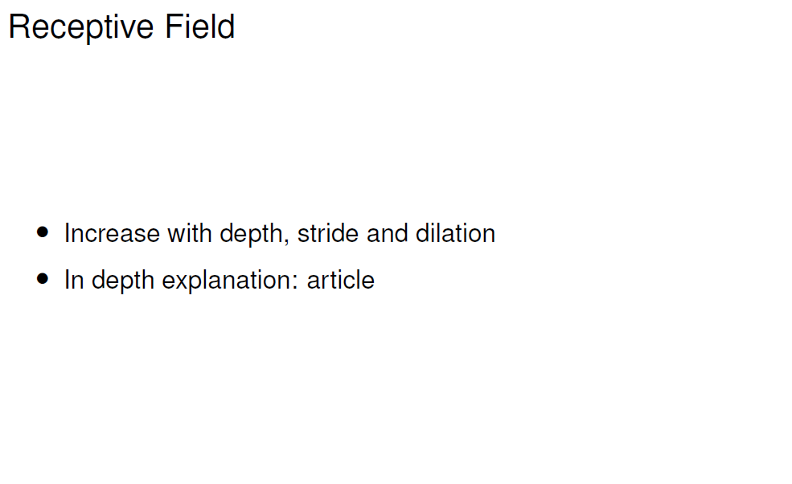
In a CNN, each layer "looks at" the output of the previous layer. As you go deeper into the network, the receptive field of the neurons grows.
A neuron in a deep layer might be influenced by a large portion or even all, of the original input image, even though it's only directly looking at a small patch of the layer before it.
Source

Slide 36
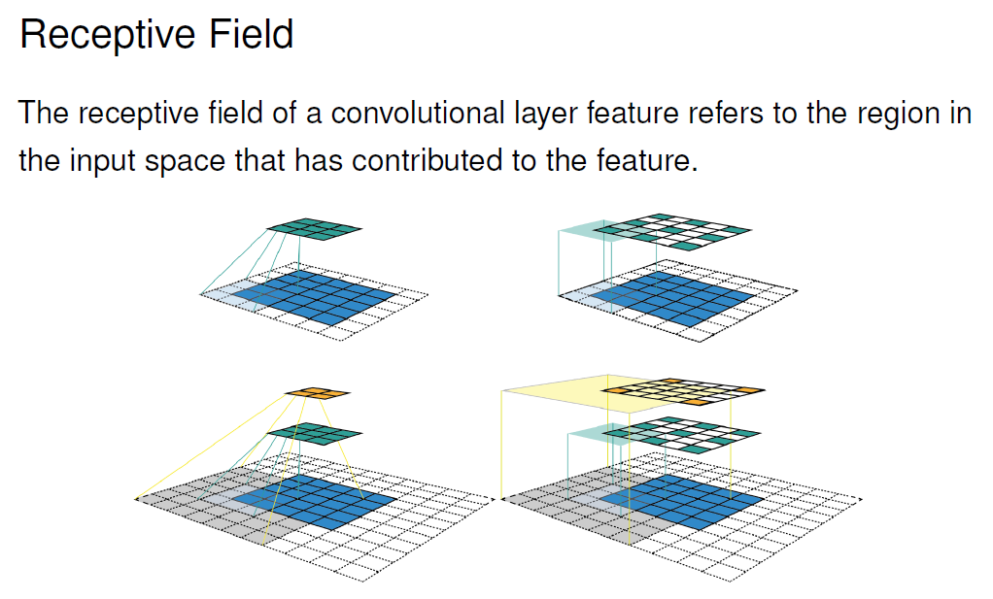

Slide 37
Code Discussion
Convolution & Intro to PyTorch

Slide 38
Computer Vision
Metrics for Image Classification
Dr. Umberto Michelucci, Dr. Aygul Zagidullina

Slide 39
Confusion Matrix (binary classification)
Number of inputs classified as 0 and that have a true class of 0 (TRUE POSITIVES, TP)
Number of inputs classified as 1 and that have a true class of 0 (FALSE NEGATIVES, FN)
In the case of the perfect classifier:
FN = 0 and FP = 0
True Label 0
Number of inputs classified as 0 and that have a true class of 1 (FALSE POSITIVES, FP)
Number of inputs classified as 1 and that have a true class of 1 (TRUE NEGATIVES, TN)
True Label 1
Predicted Label 0
Predicted Label 1

Slide 40
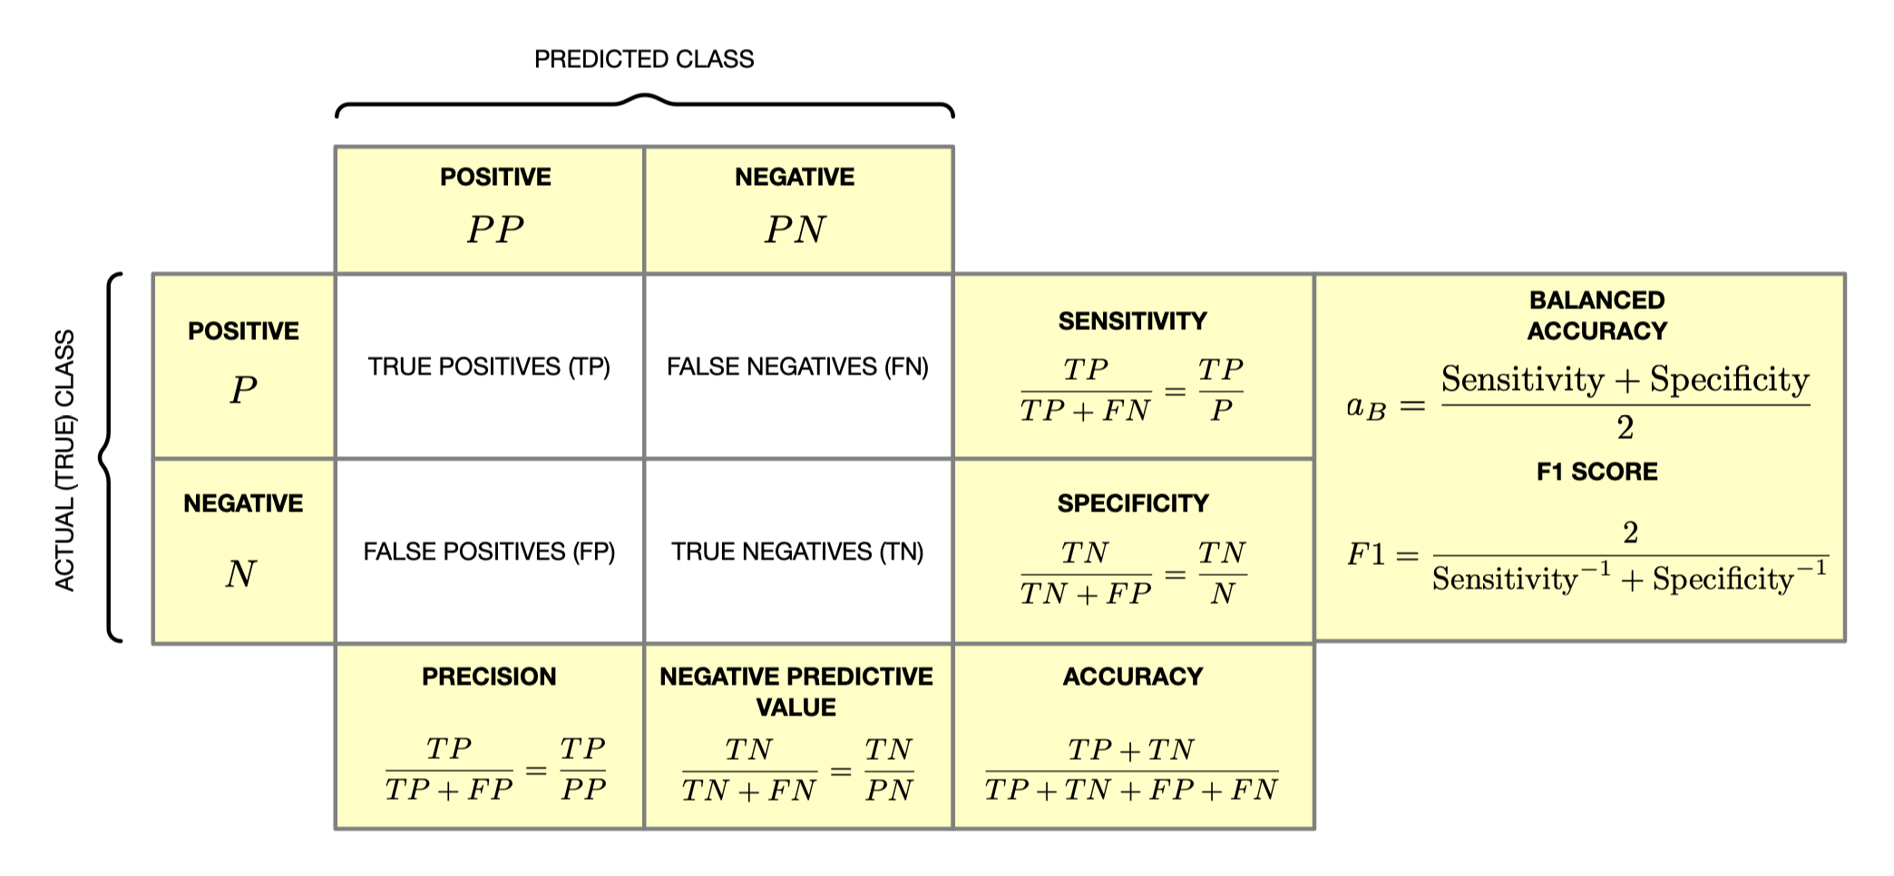
Summary – confusion matrix

Slide 41
Note
All the previous metrics can be used in any segmentation task. You treat each pixel as correctly classified or wrongly classified. So you are dealing with a binary classification problem
But you must be careful when the portion of the image to be segmented is very small. You will easily get high accuracy but the segmentation could be very poor.

Slide 42
Confusion Matrix (Multi-class classification)
Number of inputs classified as 0 and that have a true class of 0
Number of inputs classified as 1 and that have a true class of 0
Number of inputs classified as 2 and that have a true class of 0
…
True Label 0
Number of inputs classified as 0 and that have a true class of 1
Number of inputs classified as 1 and that have a true class of 1
True Label 1
…
…
…
…
…
Predicted Label 0
Predicted Label 1
Predicted Label 2

Slide 43
Computer Vision
Metrics for Image Localization
Dr. Umberto Michelucci, Dr. Aygul Zagidullina

Slide 44
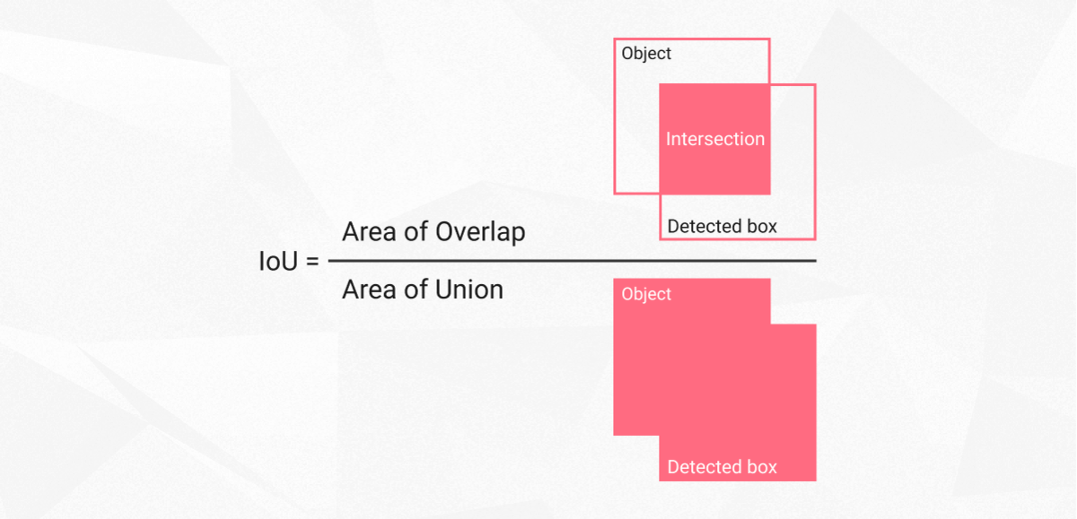
Intersection Over Union (IoU)
Intersection over union is actually a very straightforward and self-explanatory measurement and is based on the Jaccard index (a coefficient for similarity for two sets of data)
https://www.superannotate.com/blog/intersection-over-union-for-object-detection

Slide 45
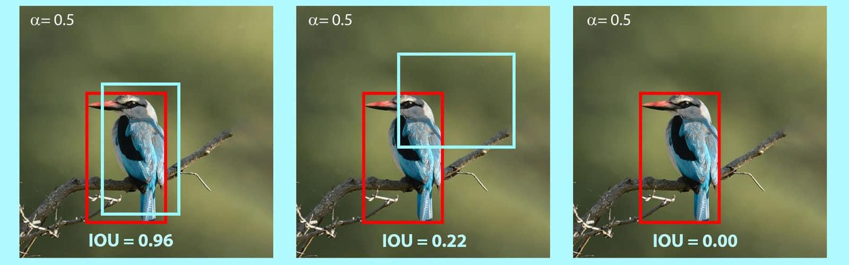
IoU - An example
https://learnopencv.com/intersection-over-union-iou-in-object-detection-and-segmentation/

Slide 46
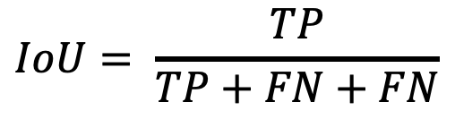
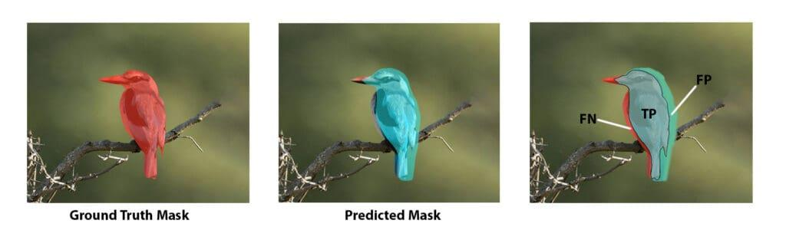
Intersection Over Union (IoU)
https://www.superannotate.com/blog/intersection-over-union-for-object-detection

Slide 47
Computer Vision
Transfer Learning
Dr. Umberto Michelucci, Dr. Aygul Zagidullina

Slide 48
Biggest trick in computer vision and deep learning

Slide 49
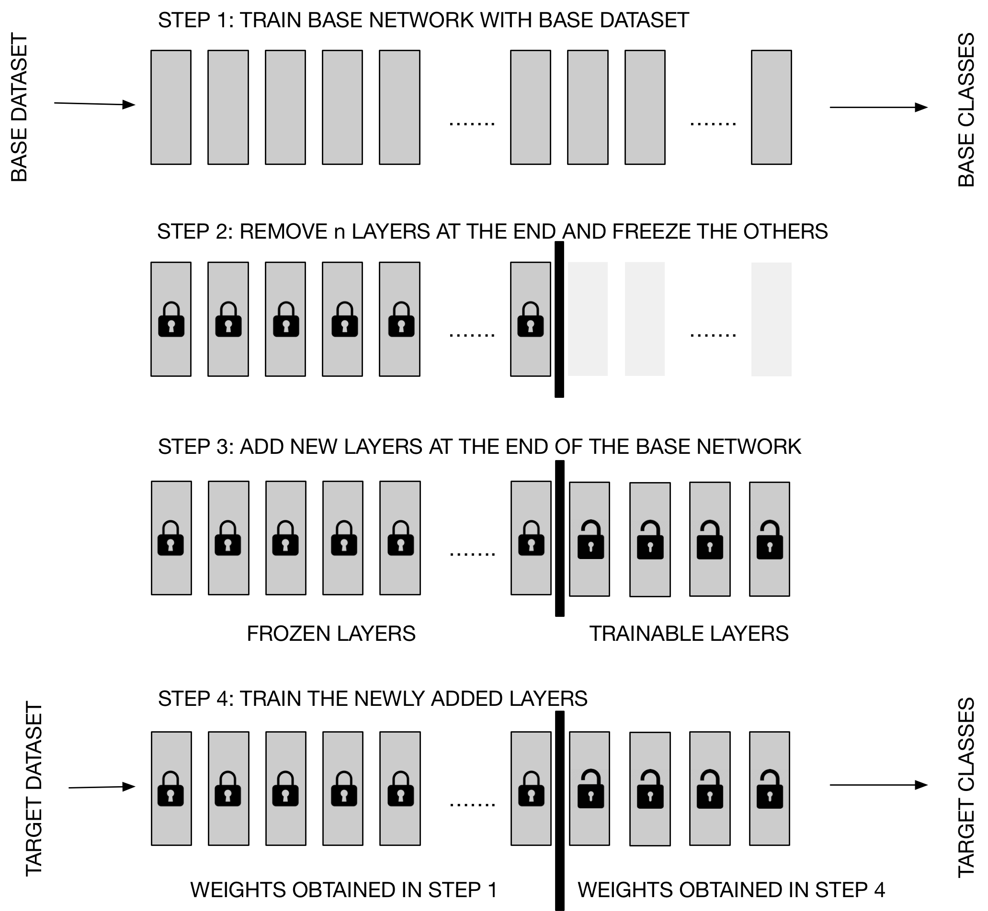
Transfer Learning
Step 1
Step 2
Step 3
In this approach, the entire network has to be trained several times (to tune the hyperparameters). This can be slow.
Step 4
Quelle: Michelucci, U. (2019). Advanced applied deep learning: convolutional neural networks and object detection. Apress.

Slide 50
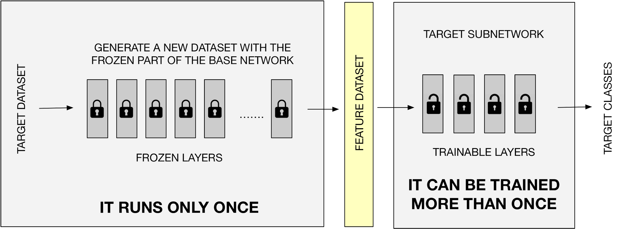
We can make transfer learning more efficient.
Quelle: Michelucci, U. (2019). Advanced applied deep learning: convolutional neural networks and object detection. Apress.

Slide 51
A few numbers (how to become more efficient)
Approach 1 (Naïve)
Approach 2 (Smart)
1 EPOCH 🡪 4.5 minutes
1 EPOCH 🡪 6 seconds
100 EPOCH 🡪 7.5 hours
100 EPOCH 🡪 10 minutes
The numbers come from a test with a "dog/cat" image dataset of about 800 MB. All information can be found in Michelucci, U. (2019). Advanced applied deep learning: convolutional neural networks and object detection. Apress.

Slide 52
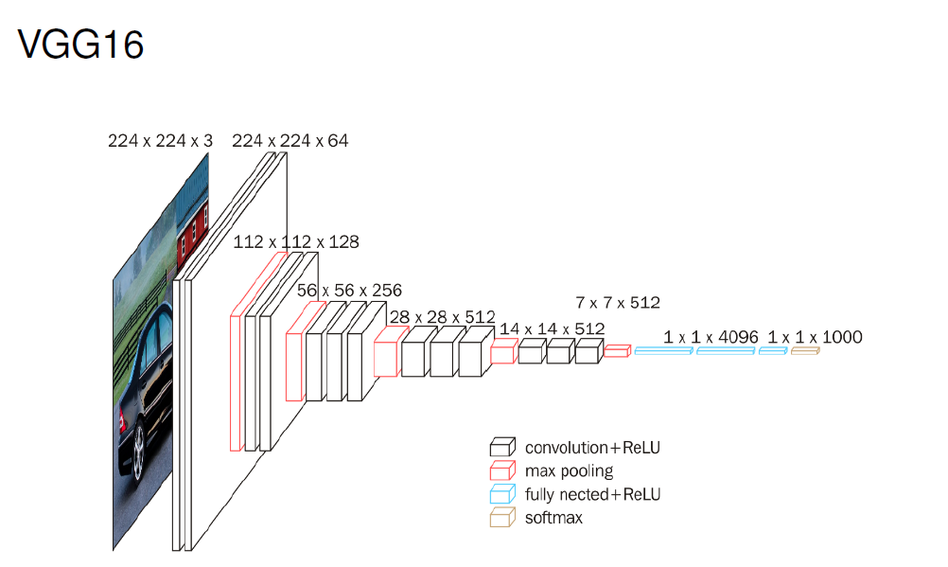
Original Paper: https://arxiv.org/pdf/1409.1556

Slide 53
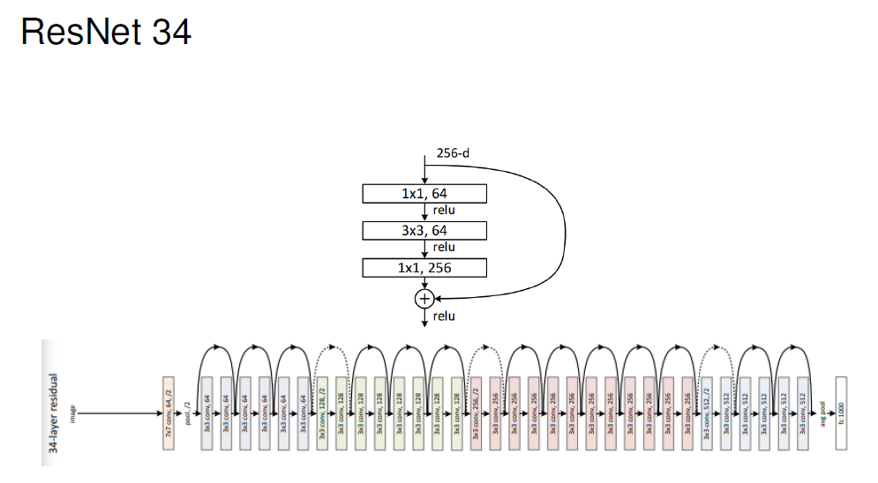
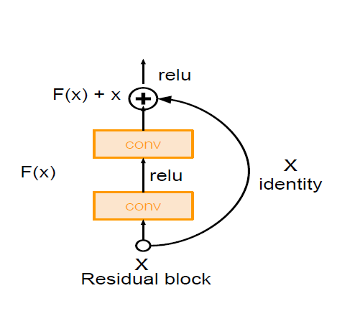
Original Paper: https://arxiv.org/abs/1512.03385
Notes:
A standard network layer tries to learn a direct mapping, let's call it H(x), from an input x. A residual block, however, reformulates this. Instead of learning H(x) directly, it learns a residual function, F(x), which is the difference between the desired output and the input.

Slide 54
Code Discussion
Transfer Learning

